Slide 1

Android Studio IDE Settings
Chapter 2

Slide 2

Introduction to Android Studio

Slide 3
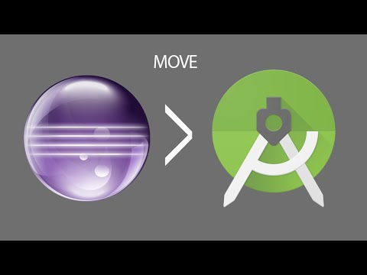
Why Android Studio ?
Android studio is an IDE used for Android application development
Developed by Google.
Android studio is a development of the Eclipse IDE, and is based on the popular Java IDE, IntelliJ IDEA.
Android studio replaces Eclipse as the official IDE for
Android application development.

Slide 4
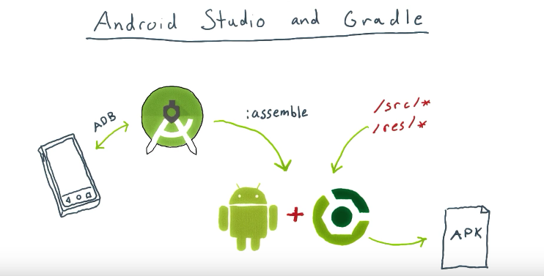
What is Gradle ?
If Eclipse uses Ant, Android studio uses Gradle as the build environment.
Gradle is a build tool used in Android Studio, to compile / run Application projects that are being developed, based on settings or configurations in the Gradle Script section.
If the Eclipse build tool used is Ant, Gradle is a development built from Ant, Maven, and the lvy repositories.

Slide 5
System requirements - Windows
Microsoft® Windows® 7/8/10 (64-bit)
4 GB RAM minimum, 8 GB RAM recommended
2 GB of available disk space minimum, 4 GB Recommended (500 MB for IDE + 1.5 GB for Android SDK and emulator system image).
1280 x 800 minimum screen resolution

Slide 6
System Requirements - Mac
Mac® OS X® 10.10 (Yosemite) or higher, up to 10.14 (macOS Mojave)
4 GB RAM minimum, 8 GB RAM recommended
2 GB of available disk space minimum, 4 GB Recommended (500 MB for IDE + 1.5 GB for Android SDK and emulator system image)
1280 x 800 minimum screen resolution

Slide 7
System Requirements - Linux
GNOME or KDE desktopTested on gLinux based on Debian.
64-bit distribution capable of running 32-bit applications
GNU C Library (glibc) 2.19 or later
4 GB RAM minimum, 8 GB RAM recommended
2 GB of available disk space minimum, 4 GB Recommended (500 MB for IDE + 1.5 GB for Android SDK and emulator system image)
1280 x 800 minimum screen resolution

Slide 8
System Requirements - Chrome OS
8 GB RAM or more recommended
4 GB of available disk space minimum
1280 x 800 minimum screen resolution
Intel i5 or higher (U series or higher) recommended

Slide 9
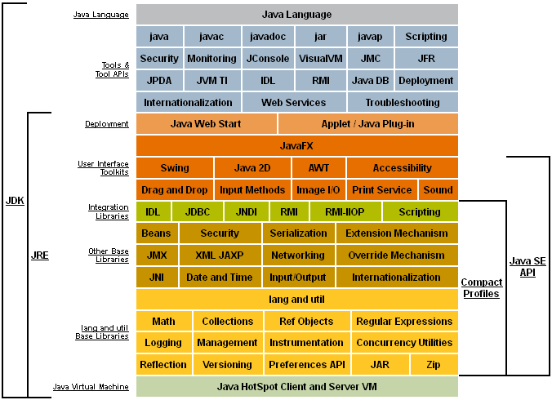
Java Development Kit (JDK)
The Java Development Kit (JDK) is a software development environment used for developing Java applications and applets.
It includes the Java Runtime Environment (JRE), an interpreter/loader (java), a compiler (javac), an archiver (jar), a documentation generator (javadoc) and other tools needed in Java development.

Slide 10

Download JDK
The Android studio SDK is developed using the Java programming language, so the Java Development Kit (JDK) is the first component that must be installed.
Download jdk at: http://www.oracle.com/technetwork/java/javase/downloads/jdk8-downloads-2133151.html
Install the JDK.
Path setting your jdk.

Slide 11
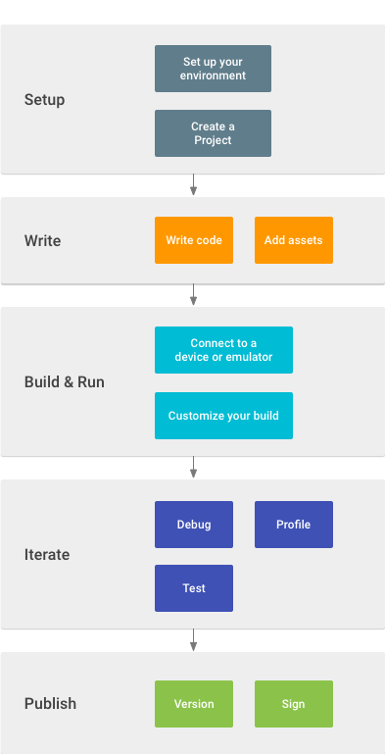
Developer workflow basics
Set up your workspace
Write your app
Build and run
Debug, profile, and test
Publish
https://developer.android.com/studio/workflow

Slide 12
Programming Language in Android Studio
In developing Android-based applications using the Java programming language.
On May 7, 2019, Google officially used Kotlin for Android app development.
Kotlin is developed by JetBrains. JetBrains is a software development company that is also the developer of the IntelliJ IDE (Integrated Development Environment).
Difference between java and kotlin:
Multi Platform
Compile Time
Null Safety
Community
Writing Source Code
https://www.dicoding.com/blog/java-atau-kotlin-untuk-android/

Slide 13
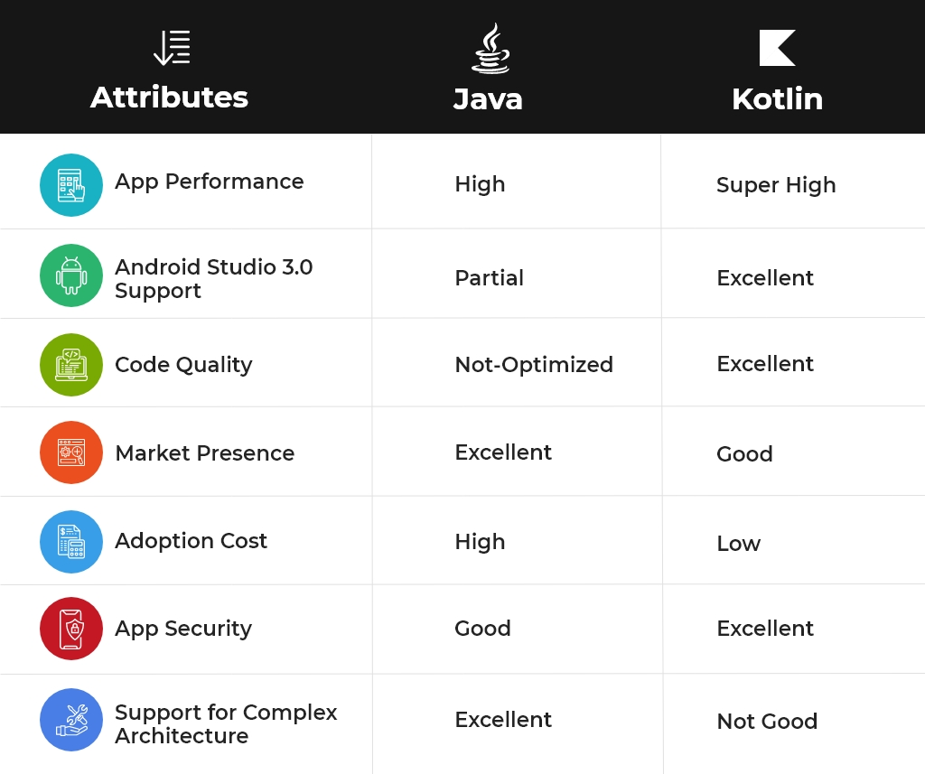
Java vs Kotlin

Slide 14

Java or Kotlin

Slide 15
The Android Emulator
The Android Emulator simulates Android devices on your computer so that you can test your application on a variety of devices and Android API levels without needing to have each physical device.
The emulator provides almost all of the capabilities of a real Android device. You can simulate incoming phone calls and text messages, specify the location of the device, simulate different network speeds, simulate rotation and other hardware sensors, access the Google Play Store, and much more.
Testing your app on the emulator is in some ways faster and easier than doing so on a physical device. For example, you can transfer data faster to the emulator than to a device connected over USB.
The emulator comes with predefined configurations for various Android phone, tablet, Wear OS, and Android TV devices.
https://developer.android.com/studio/run/emulator

Slide 16
Run your app - Run on a real device
Connect your device to your development machine with a USB cable. If you developed on Windows, you might need to install the appropriate USB Driver for your device.
Perform the following steps to enable USB debugging in the Developer options window:
Open the Settings app.
If your device uses Android v8.0 or higher, select System. Otherwise, proceed to the next step.
Scroll to the bottom and select About phone.
Scroll to the bottom and tap Build number seven times.
Return to the previous screen, scroll to the bottom, and tap Developer options.
In the Developer options window, scroll down to find and enable USB debugging.

Slide 17
Run your app - Run on a real device (Cont..)
3. Run the app on your device as follows :
In Android Studio, select your app from the run/debug configurations drop-down menu in the toolbar.
In the toolbar, select the device that you want to run your app on from the target device drop-down menu.
4.Click Run
https://developer.android.com/training/basics/firstapp/running-app

Slide 18
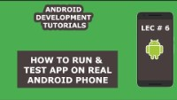
On a real device Setings

Slide 19
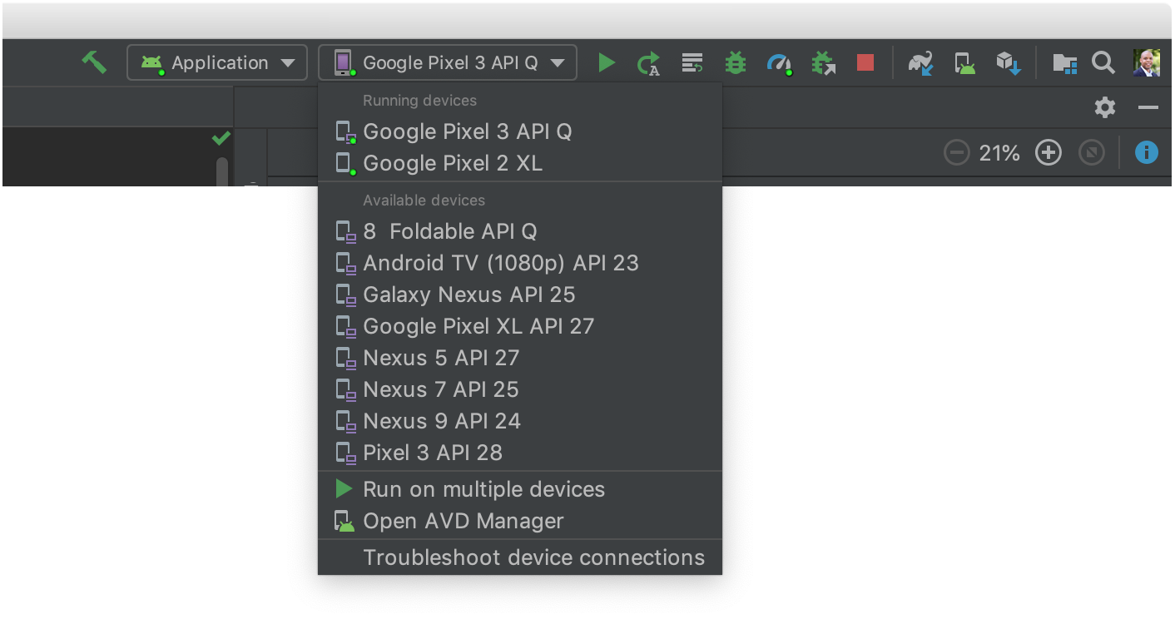
Run on an emulator
In Android Studio, create an Android Virtual Device (AVD) that the emulator can use to install and run your app.
In the toolbar, select your app from the run/debug configurations drop-down menu.
From the target device drop-down menu, select the AVD that you want to run your app on.
Click Run
https://developer.android.com/training/basics/firstapp/running-app

Slide 20
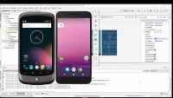
Create Virtual Device (AVD) Emulator Android Studio and Run App

Slide 21
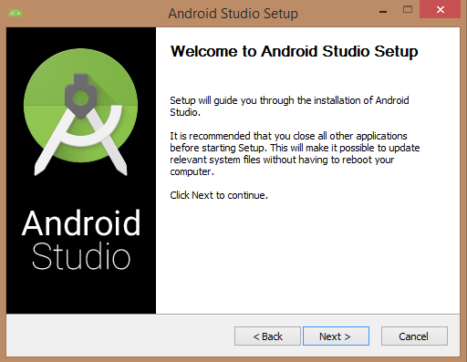
Downloading The Android Studio Package
Visit and download
https://developer.android.com/studio/index.html
Instaling Android Studio
Pemrograman Mobile (CS307) Chapter 2

Slide 22
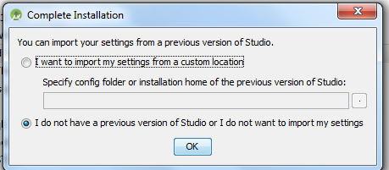
Instaling Progress
Wait for the installation process to complete.
The first time Android Studio is run, a dialog will appear providing options to import settings from the previous Android version.
If this is the first time you are installing then select "I don't have a previous version of Android Studio or I don't want to import my settings" and click the OK button.

Slide 23
Finish Progress
Please install the downloaded Android Studio.
Please wait for Aandroid Studio to update Gradle.
For the first time, Android Studio must be connected to the internet to update Gradle.
Happy waiting and good luck

Slide 24
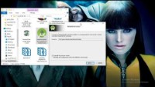
Android Studio Installing

Slide 25
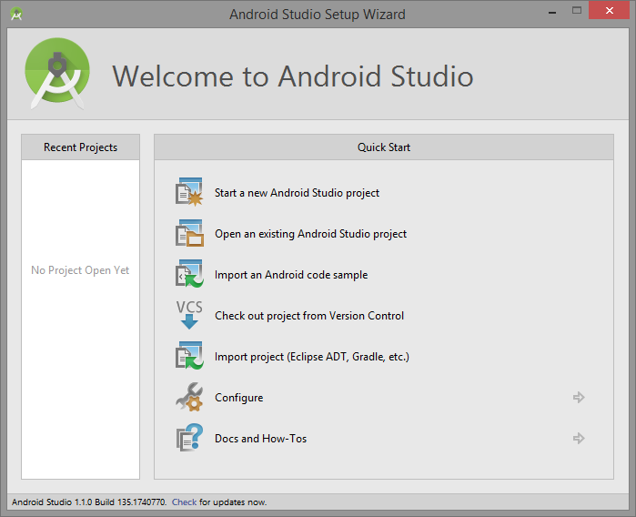
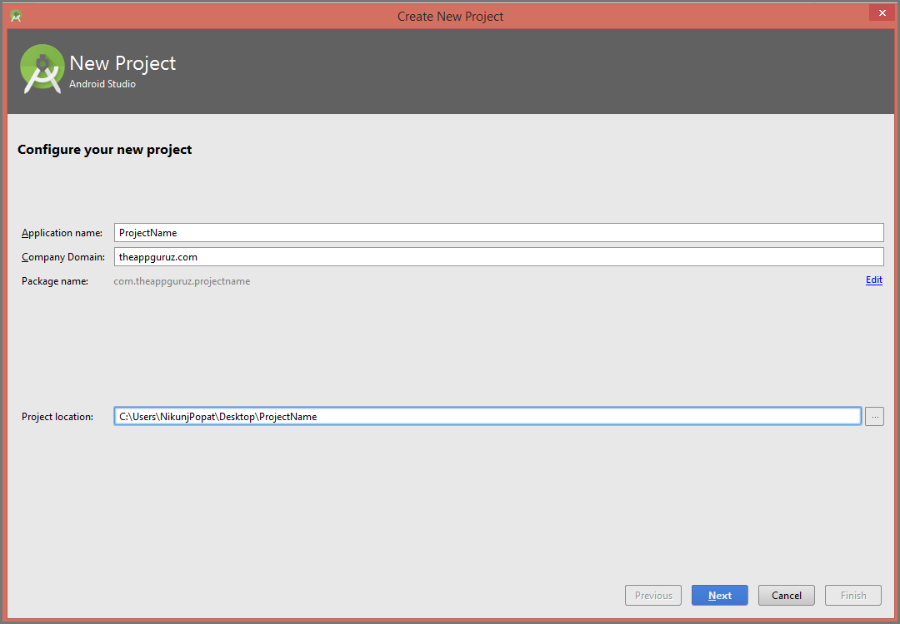
Start Android Studio

Slide 26
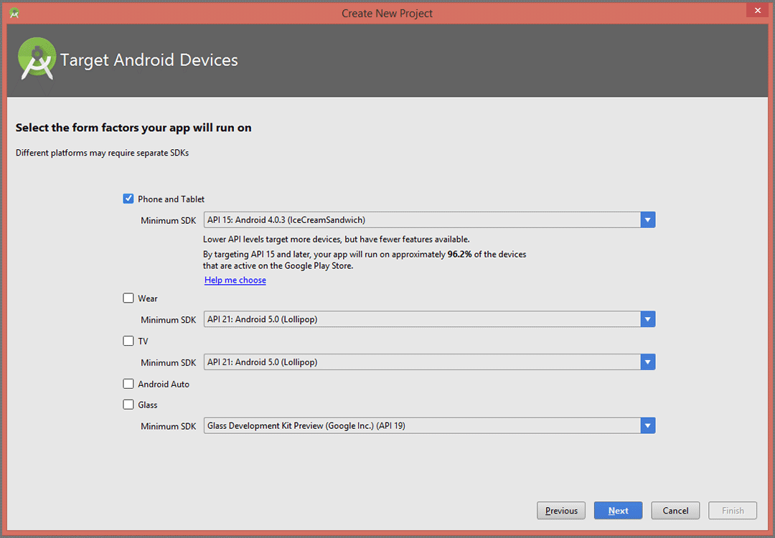
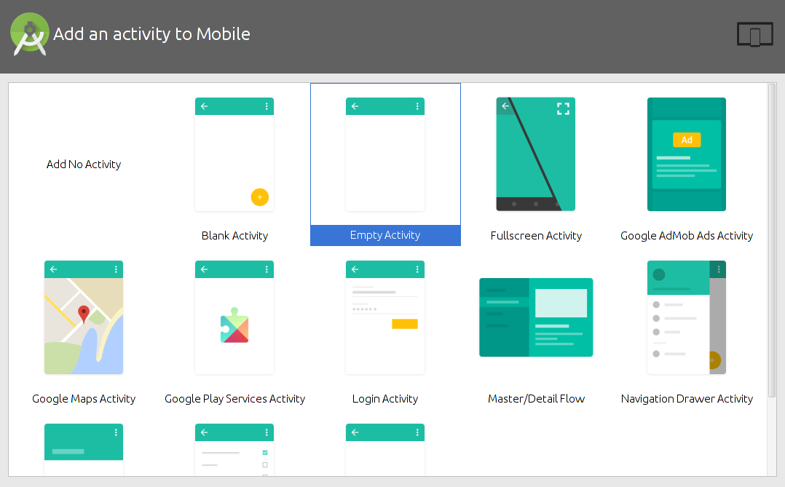
Start Android Studio

Slide 27
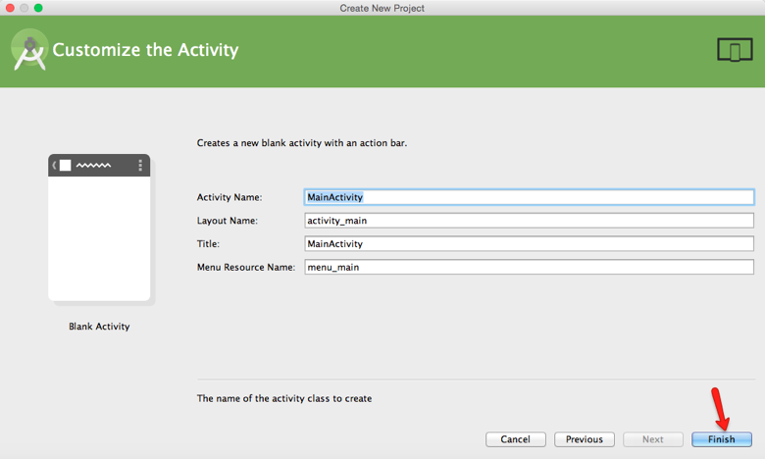
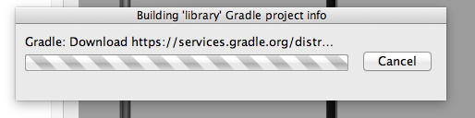
Start Android Studio

Slide 28
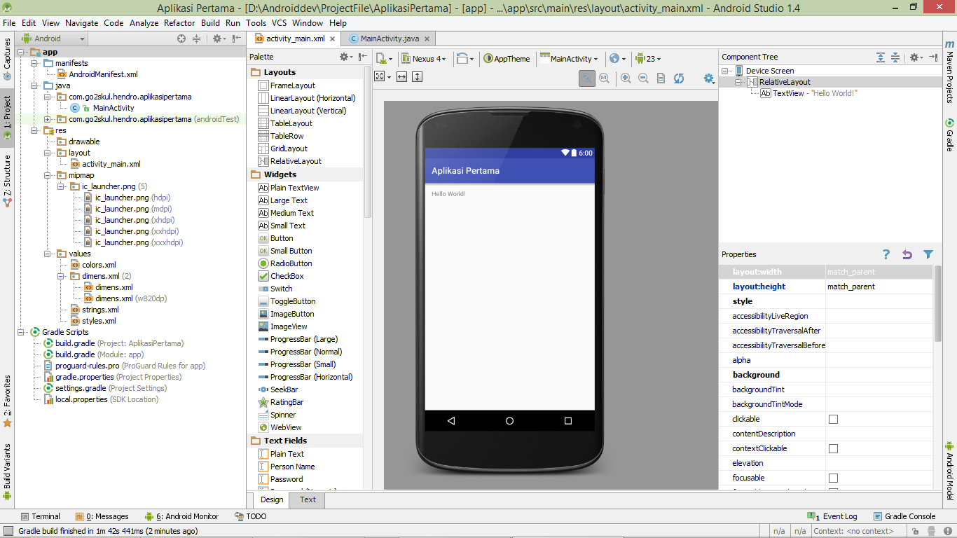
Practice

Slide 29
Run App
What are the results?
What is the difference between using emulators and real devices?

Slide 30
References
https://developer.android.com/studio/install?hl=id
https://developer.android.com/training/basics/firstapp/running-app

Slide 31

http://jancok.com/uploads/posts/t/l-154.jpg

Slide 32
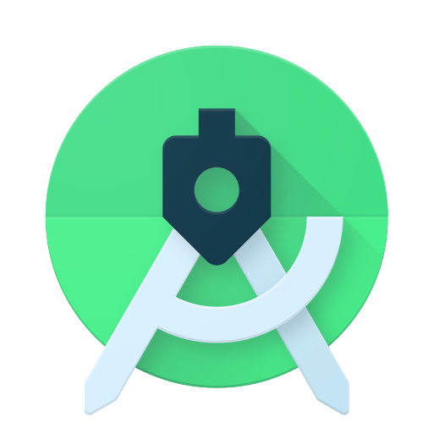
Thank You
See you next week

